Slide 1
LECTURE - 2
ON
EEE 154
Prof. Md. Monowar Hossain

Slide 2
Course Contents
Lettering, numbering and heading; plane geometry. Projection (Solid Geometry).
Development and true shape: cube, pyramid, cone, prism; section and true shape.
Isometric drawing, oblique drawing.
Plan, elevation and section of engineering structures.
Introduction to Computer-Aided Design (CAD)

Slide 3
What is called Drawing??
An engineering drawing is a type of technical drawing that communicates how a component or system is to be constructed or assembled. It is used to convey information about an object.
It is a universal language that conveys information about dimensions, materials, processes, and tolerances, ensuring that engineers, architects, and manufacturers can collaborate effectively.
A common use is to specify the geometry necessary for constructing a component called a detailed drawing.
Usually, several drawings are necessary to specify even a simple component completely.

Slide 4
What is Called Lettering??
In the context of drawing, the art of creating and designing letters, often with a focus on aesthetics and visual appeal, is called lettering or hand-lettering.
Lettering in engineering drawing is the art of writing essential text on technical drawings.
It ensures clear communication of details, specifications, and measurements.
Why is it so important?
Because without proper lettering, even the most precise drawing can become confusing.
Note that lettering differs from calligraphy, which emphasizes the act of writing.

Slide 5
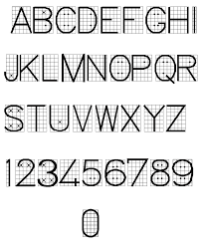
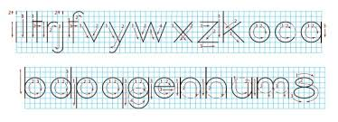
Lettering & Numbering

Slide 6
Importance of Engineering Drawing
Engineering drawings are essential tools in the design and manufacturing processes, helping to translate ideas into tangible products.
Communication: Facilitates clear communication among engineers, architects, and manufacturers.
Precision: Ensures accuracy in the construction and assembly of parts.
Documentation: Serves as a permanent record of designs and specifications.
Standards Compliance: Adheres to industry standards, ensuring consistency and compatibility in engineering practices.

Slide 7
Types of Drawing
Orthographic Projection
Isometric Drawing
Sectional Drawing
Detail Drawing
Assembly Drawing
Schematic Drawing
Piping and Instrumentation Diagram (P&ID)
Floor Plan

Slide 8

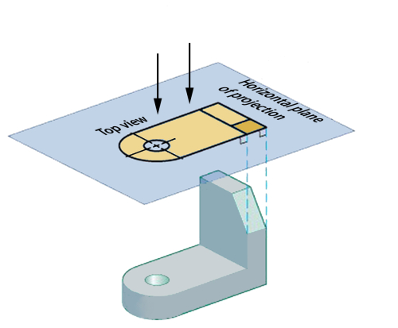
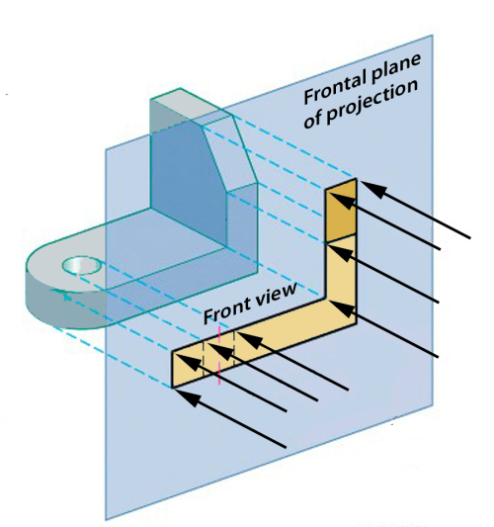
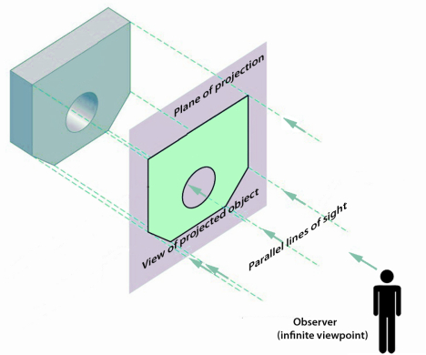
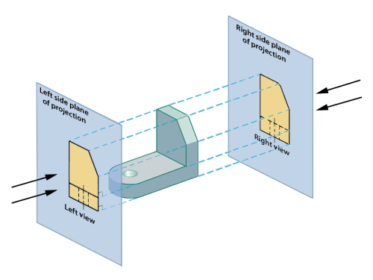
Orthographic Projection
If the distance from the observer to the object is infinite, then the projection lines are assumed to be parallel, and the projection is called a parallel projection. Parallel projection is orthographic if the plane of projection is placed between the observer and the object, and the plane is perpendicular to the parallel lines of sight.
Image source: Projections and Views, Engineering Design, McGill University

Slide 9
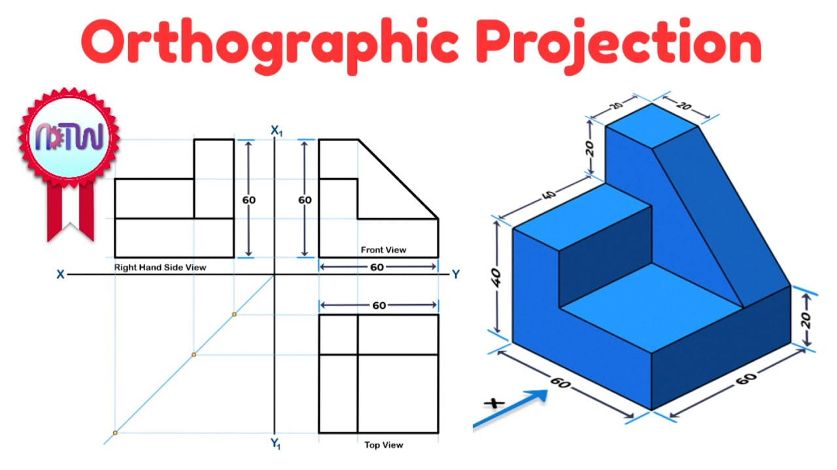
Orthographic Projection:
A two-dimensional representation of a three-dimensional object, showing multiple views (typically front, top, and side) to provide clear and precise dimensions and details of the object.

Slide 10
Orthographic Projection:
Orthographic projection: A type of pictorial drawing that represents a 3D object on a 2D plane
Shows three (four) faces of an object simultaneously: front, top, and right side (left side)
Helps visualize the object as it appears in real space
Provides a clear and realistic view of the object
Used in design sketches, manuals, and assembly guides
Bridges the gap between orthographic views and the real 3D form

Slide 11
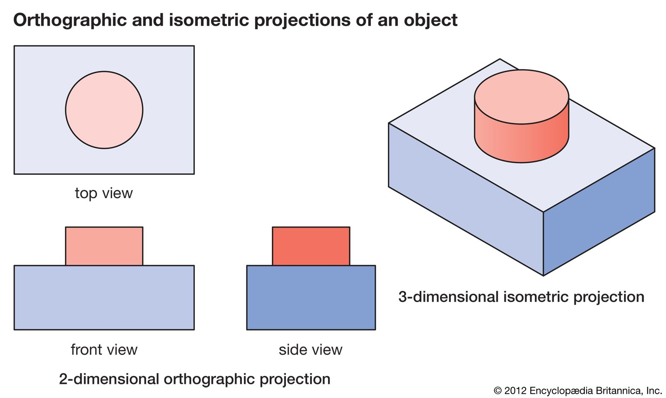
Isometric Drawing
A type of axonometric drawing where the three dimensions of an object are represented in one view, with the axes spaced 120 degrees apart. To give a more realistic view of the object while maintaining proportionality.
An isometric drawing is a 3D representation of an object on a 2D surface, where all three dimensions (length, width, and height) are shown at equal angles and preserve their true lengths.
It's a type of pictorial projection, often used in technical and engineering drawings to illustrate how components fit together and to convey spatial relationships.
The term "isometric" comes from the Greek words "isos" (equal) and "metron" (measure), indicating that all three axes are equally foreshortened

Slide 12
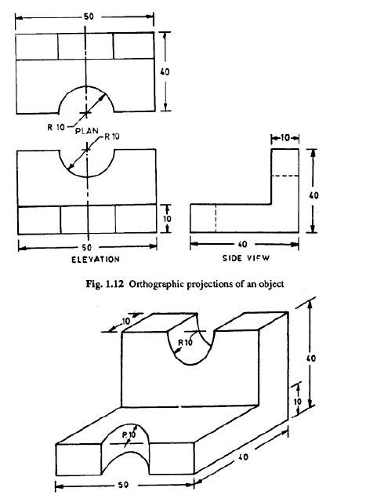
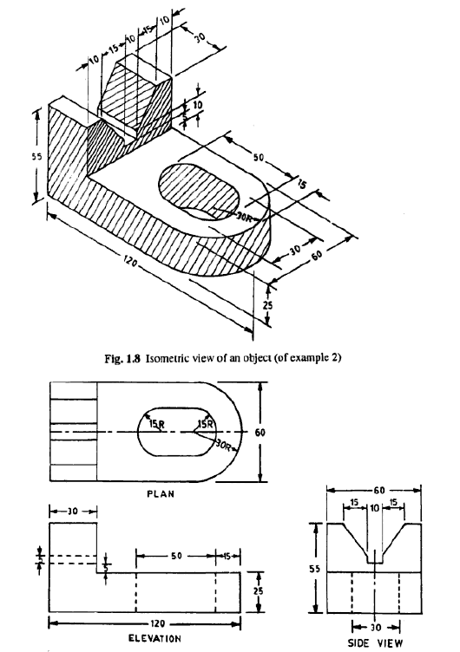

Slide 13
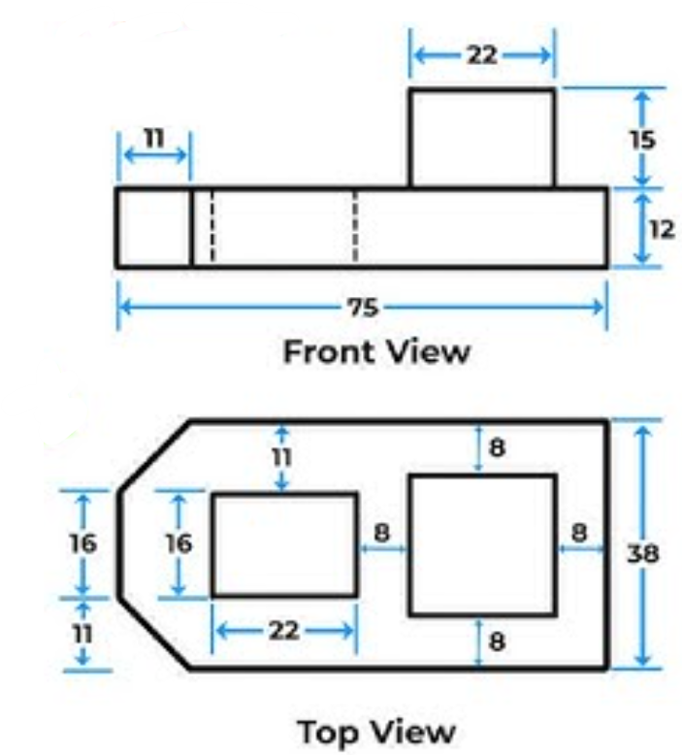
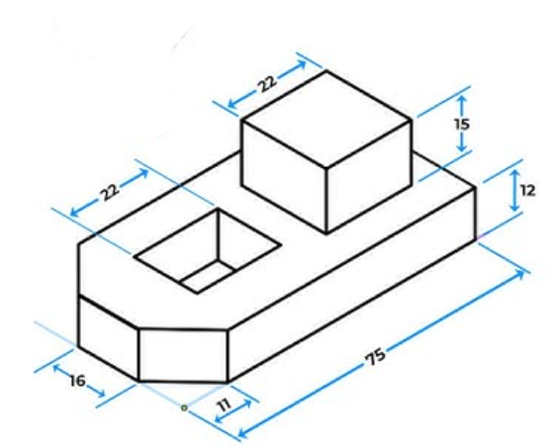
Example

Slide 14
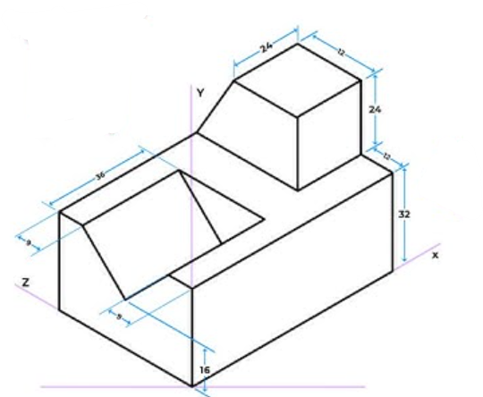
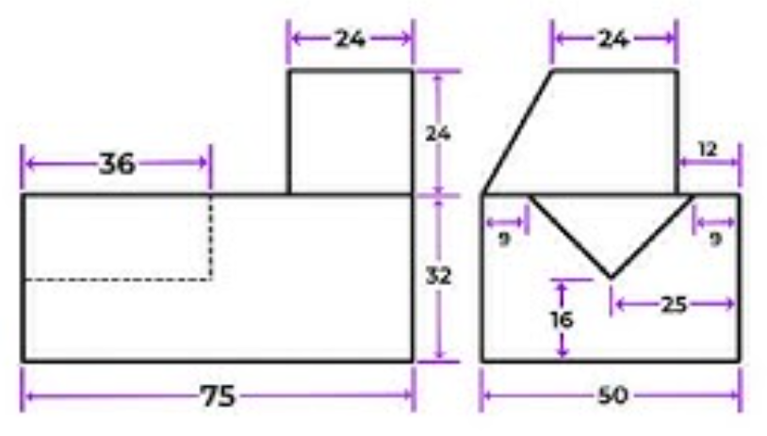
Example
Front
Side (left)

Slide 15
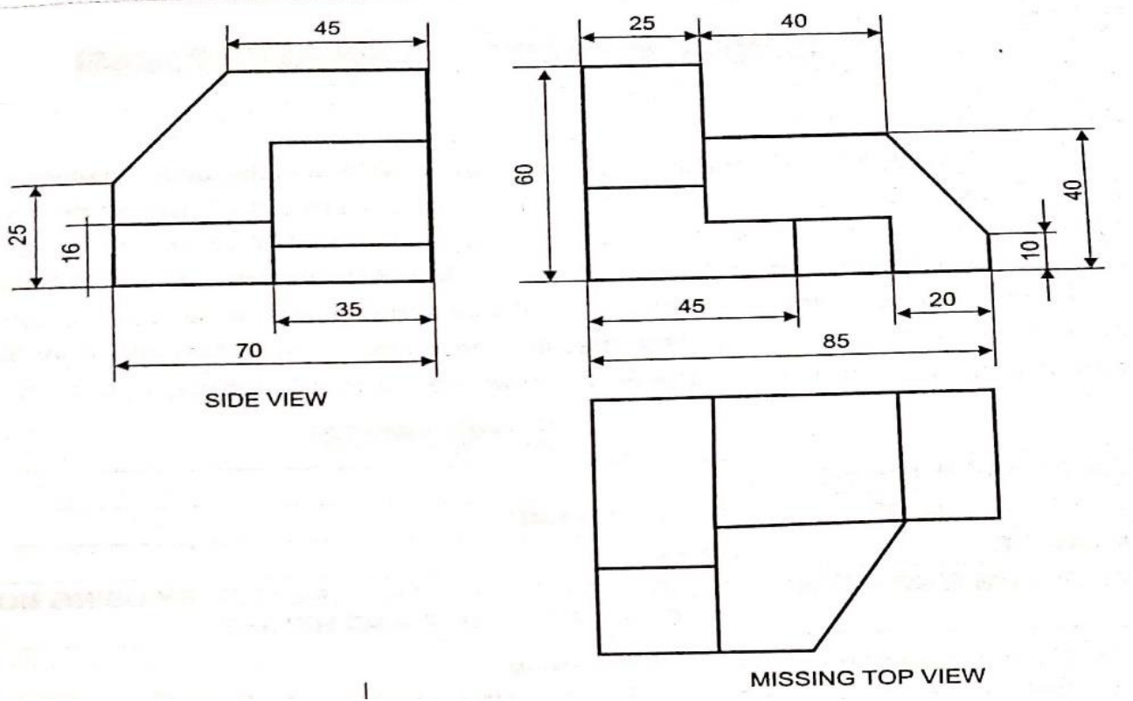
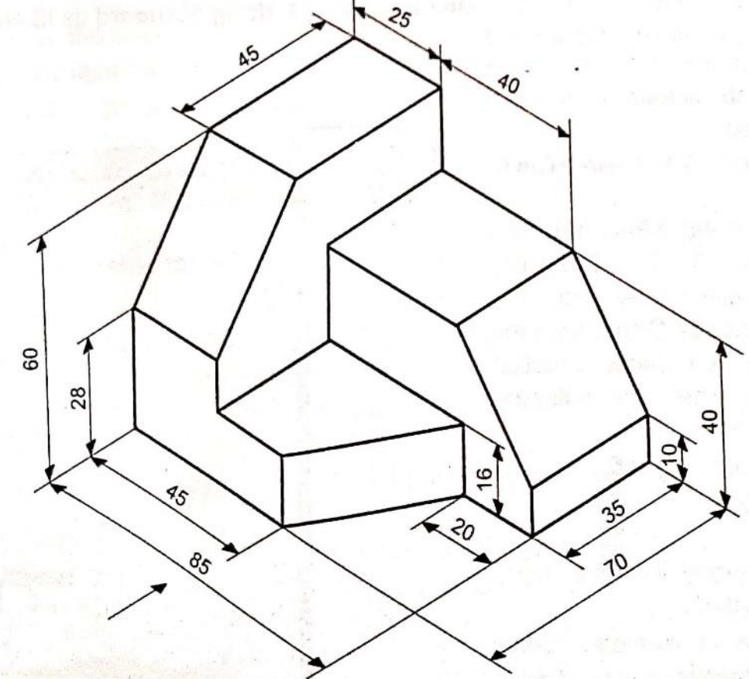
Example

Slide 16
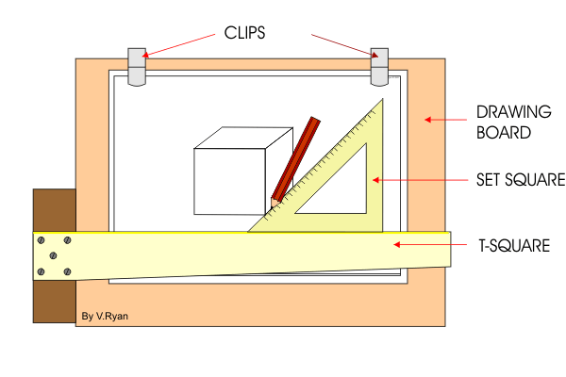
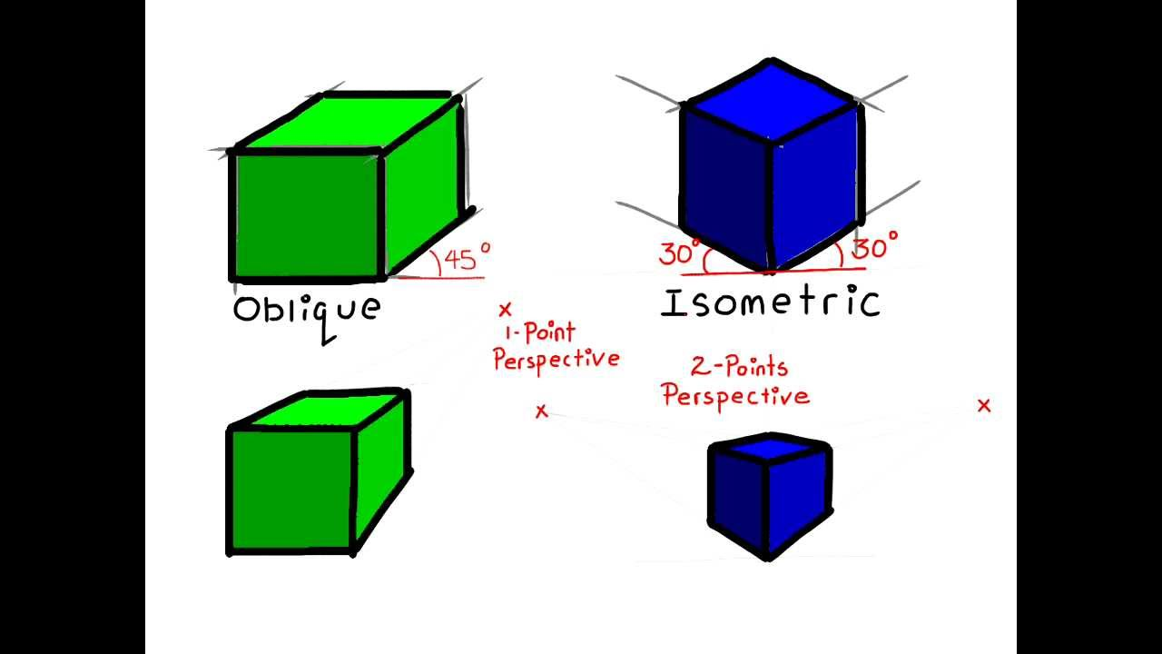
Oblique Drawing
Oblique drawing is a simple 3D drawing technique where one face of an object is shown in its true shape and size, while the other faces are drawn at an angle.
It's a quick way to represent objects in three dimensions, often used for sketching or when a realistic view isn't critical

Slide 17
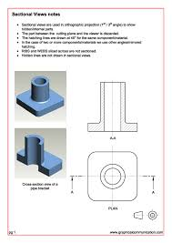
Sectional Drawing
A representation that shows the internal features of an object by cutting through it to reveal details that are not visible in exterior views, such as internal components or assemblies.

Slide 18
Detail Drawing
A drawing that provides a detailed view of a specific part or assembly, often at a larger scale to clarify complex features or dimensions that need more explanation.
It includes detailed information about the part's dimensions, shape, materials, manufacturing processes, and other specifications needed for its construction or fabrication.
Detail drawings are essential for ensuring accuracy and clarity in construction, manufacturing, and engineering projects

Slide 19
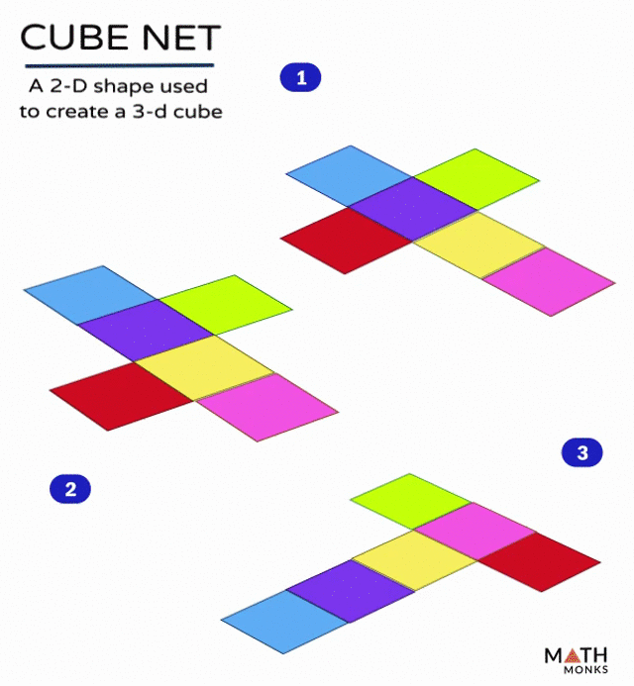
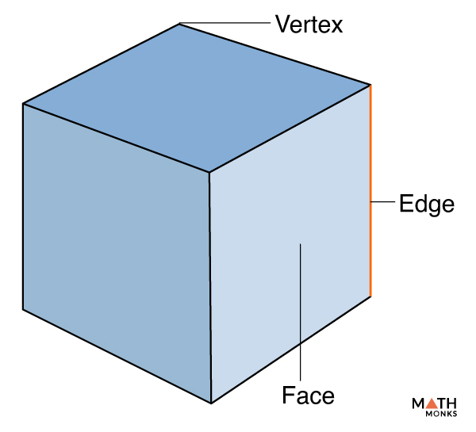
Cube?
A Cube is a solid three-dimensional figure that has 6 square faces, 8 vertices, and 12 edges. It is also said to be a regular hexahedron. You must have seen a 3 × 3 Rubik's cube, which is the most common example in the real-life

Slide 20
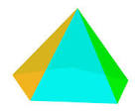
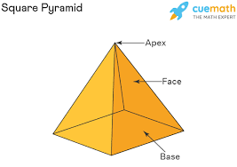
What is called pyramid?
A pyramid is a three-dimensional geometric shape with a polygonal base and triangular sides that meet at a point called the apex.

Slide 21
Details of Pyramid
Base: The base of a pyramid can be any polygon (triangle, square, pentagon, etc.).
Sides: The sides of a pyramid are triangular, and they converge towards the apex.
Apex: The apex is the point where all the triangular sides meet at the top.
Types of Pyramids:
  Triangular Pyramid: A pyramid with a triangular base.
  Square Pyramid: A pyramid with a square base, like the pyramids of Egypt.
  Pentagonal Pyramid: A pyramid with a pentagonal base.
  Hexagonal Pyramid: A pyramid with a hexagonal base.

Slide 22
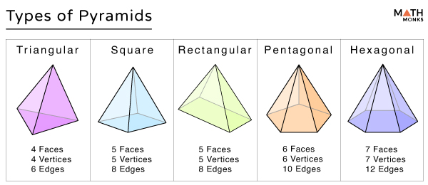
Types of Pyramids

Slide 23
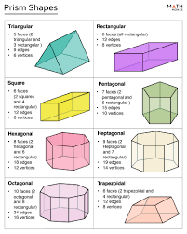
Prism
A prism is a three-dimensional geometric shape with two identical, parallel polygonal faces (bases) and other faces (lateral faces) that are parallelograms.
A prism is a polyhedron (a 3D shape with flat faces) where two faces, called bases, are congruent and parallel polygons, and the other faces are parallelograms connecting the corresponding sides of the bases.

Slide 24
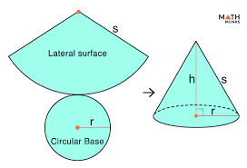
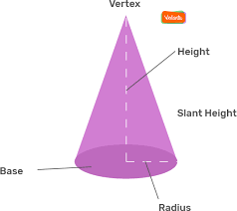

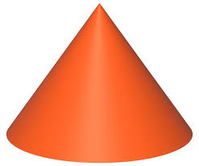
DEVELOPMENT OF CONES
The development of the lateral surface of a cone is drawn by the radial line method. The lateral development of the cone is in the form of a sector of a circle, the radius of which is equal to the slant height of the cone.

